Slide 1
Tore Alden Principal Analyst The Jacobsen
Global Vegetable Oil Markets and the Adjustment to New Biofuel Demand
Notes:
Journey of transformation
Introductions to co presenters
Housekeeping & phones

Slide 2
The Jacobsen expects six renewable diesel plants to begin production or expand capacity during the balance of 2021. In 2022, The Jacobsen predicts seven plants will open or expand.
The expansion will raise annual renewable diesel capacity from an estimated 535 million gallons per year at the beginning of 2021 to 2.75 billion gallons by the end of 2022.
The Jacobsen’s production forecasts are generally conservative relative its nameplate capacity estimates, suggesting production could be larger than predicted.
Fastmarkets | Agricultural Forecasting

Slide 3
The Jacobsen estimates feedstock demand hit a record in March, but high feedstock costs relative to revenue slowed production in April.
Despite the record high HOBO spread, the expansion of production capacity will more than triple feedstock demand by the end of 2022.
Vegetable oils will provide most of the increased usage, with soybean oil usage expected to increase significantly more than any other feedstock.
The Jacobsen expects soybean oil’s percentage of the total feedstock mix to rise from about 33 percent at the end of 2020 to about 66 percent by the end of 2022.
Fastmarkets | Agricultural Forecasting

Slide 4
Rising soybean oil use in biofuel production is expected to sharply reduce U.S. exports.
One of the biggest questions for analysts projecting soybean oil balance sheets is the level of non-biofuel use. The Jacobsen predicts non-biofuel demand will fall by about two billion pounds in 2021/22, but an expected decline in 2020/21 has not materialized despite historically high prices. Non-biofuel use in 2020/21 suggest the floor for non-biofuel use could be around 13 billion pounds.
There is some potential for the U.S. to become a net importer of soybean oil.
Fastmarkets | Agricultural Forecasting

Slide 5
Quarter soybean oil use in renewable fuel production rose to a record 2.64 billion pounds in Oct/Dec 2020, but non-biofuel use was slightly above the five-year average for the quarter.
The trend continued in the Jan/Mar quarter suggesting non-biofuel end users are not reducing demand despite the 30 percent increase in soybean oil prices in Central Illinois (44.05 cents per pound to 57.44 cents)
There are several challenges to the assumption canola oil will backfill for soybean oil demand. The most significant is the potential for the EPA to approve a pathway for canola oil to generate RINs in renewable diesel production.
Fastmarkets | Agricultural Forecasting

Slide 6
The sharp increase in soybean oil prices has slowed U.S. soybean oil export sales dramatically in 2021. The slowdown is dropping expectations for 2020/21 U.S. exports.
With the spread between U.S. soybean oil and Argentine soybean oil reaching record highs of about 15 cents per pound in the past month, Western Hemisphere countries are likely shifting purchases to Argentina.
Fastmarkets | Agricultural Forecasting

Slide 7
The bulk of U.S. soybean oil exports flow the countries in the Western Hemisphere. However, South Korea is the largest destination for U.S. soybean oil.
Further cuts in U.S. exports projections would likely cut The Jacobsen’s forecast of South Korean shipments more than other Western Hemisphere countries due to the potential for switching to palm oil.
Fastmarkets | Agricultural Forecasting

Slide 8
The cuts in U.S. shipments will increase the opportunities for Argentine shipments to Western Hemisphere countries.
Outside of Peru, the largest destinations for Argentine soybean oil are India, Bangladesh, Egypt and other African countries.
Argentine crop size and the availability of exports will be the key to summer prices. If Argentina’s crop is smaller than expected and/or farmers do not sell, soybean oil shipments could fall below The Jacobsen’s expectations.
Fastmarkets | Agricultural Forecasting

Slide 9
A sharp decline in Argentine biodiesel exports and domestic consumption have substantially reduced soybean oil consumption in 2020/21. The estimated blending rate fell to 3.9 percent in 2020 from eight percent in 2019.
The Jacobsen expects the blending rate to be five percent in 2021 before rising back to eight percent in 2022.
The Jacobsen projects record soybean oil exports of 6.8 million tonnes in 2021/22.
Fastmarkets | Agricultural Forecasting

Slide 10
Despite a sharp reduction in Argentine soybean production, The Jacobsen predicts record soybean oil production. However, a critical unknown is whether farmers will sell sufficient supplies to meet The Jacobsen’s prediction.
Another risk to The Jacobsen’s forecast is the oil share. The Jacobsen’s forecast implies record soybean meal production, requiring growth in export demand to keep inventories from increasing substantially.
Fastmarkets | Agricultural Forecasting

Slide 11
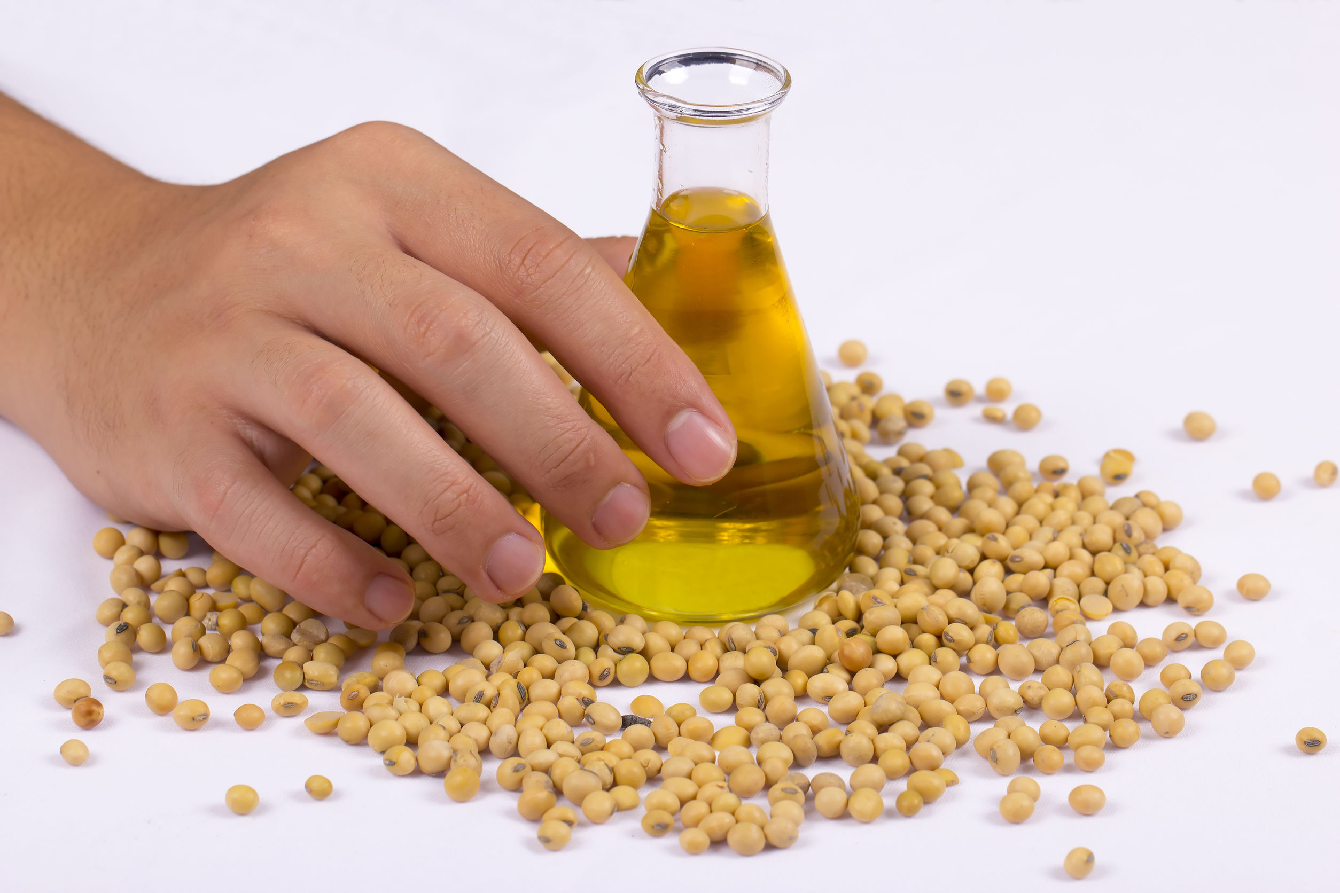

Questions?
Fastmarkets | Agricultural Forecasting

